Slide 1
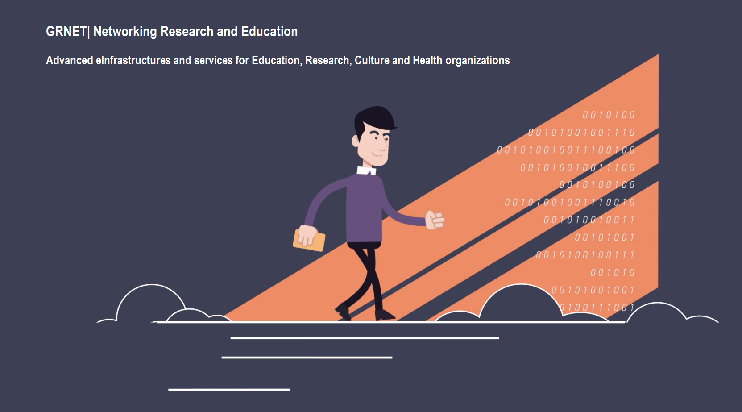





National Infrastructures for Research and Technology
National Infrastructures for Research and Technology

Slide 2
National Infrastructures for Research and Technology
State-owned company (SA) established in 1998. GRNET operates under the auspices of the Ministry of Digital Governance. GRNET receives funding from the Greek State and the European Union.
Provides advanced eInfrastructures & Services to the Greek academic and research institutions:
National and international connectivity
eInfrastructures & services (network, computing, storage) to the community
Promotion and dissemination of ICT in the communities within academic, research, health and culture sectors

Slide 3
Communities and Users @ sectors: Education, Research, Health, Culture
Organizations and Institutions
Universities
Technological Education Institutes
Research Centers
Large Research Infrastructures
Hellenic School Network
Public Libraries
Culture Centers
Content Providers
Public Administration sector
Public Health Sector (Hospitals, Blood Donation/Transfusion Services)
Type of Users
Academic and Research Community users
Students, Professors, Researchers, Academic and Administration Management, Network Operations Centers (NOC), Technical Staff
Health Sector users
Hospital: Doctors, Administration, Management, NOC, Technical
Blood Donor Volunteers
Citizens

Slide 4
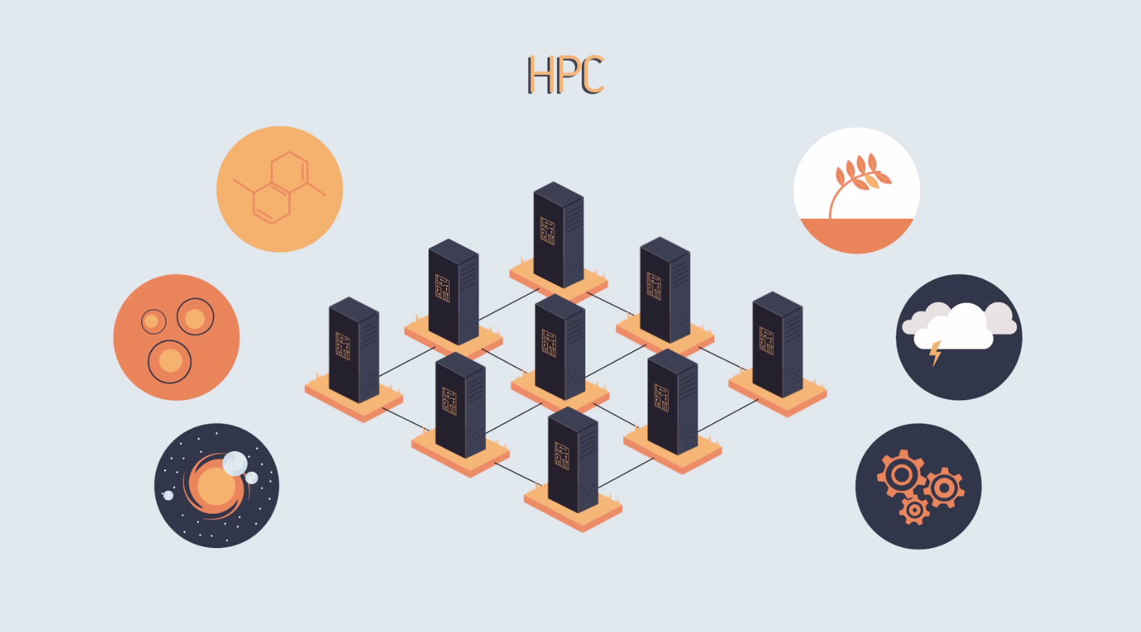
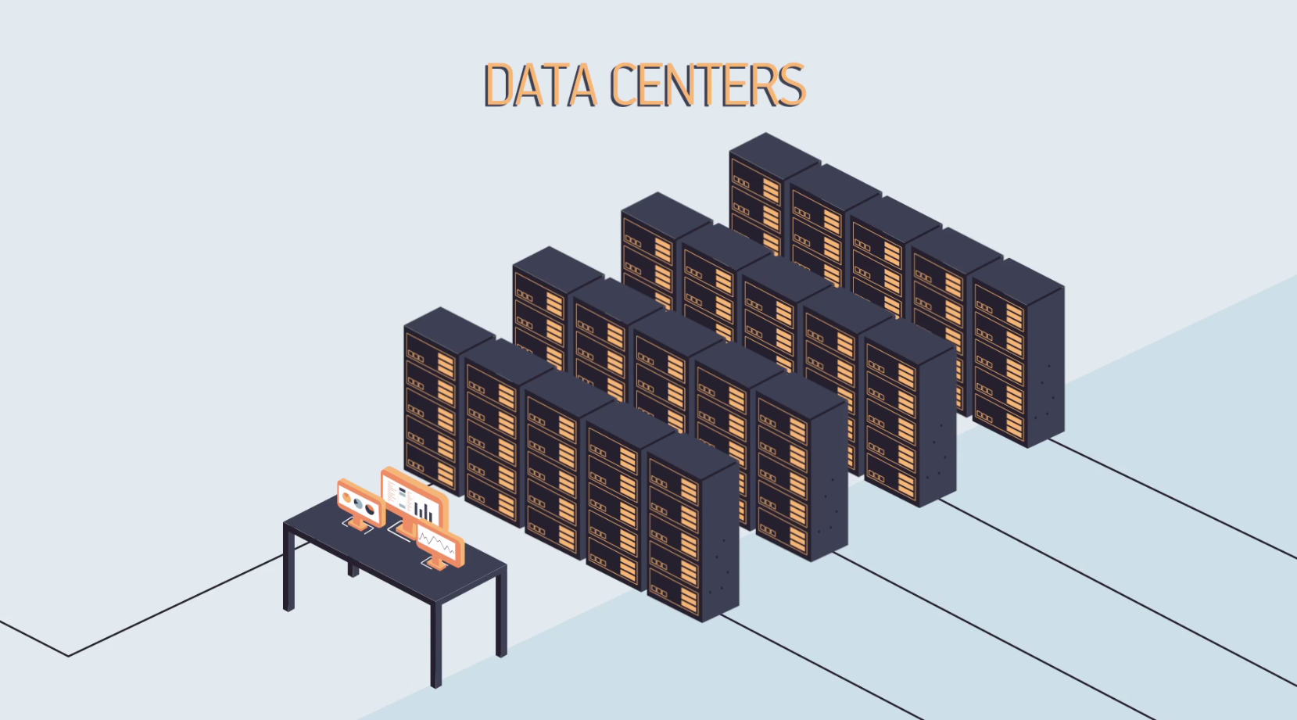
GRNET in numbers
Connects all universities, research centers, academic organizations
Dark fiber backbone (Nx10 Gbps) + Access 1 || 10 Gbps per institution
International connectivity through GEANT network multiple 10 Gbps
Operates the Greek Internet Exchange (GR-IX) node (as trusted third party) – peering all Greek ISPs and SPs up to multiple 10Gbps (open, neutral)
HPC: 444 TFlops HPC Tier–1 centre/ fat + GPU nodes, PRACE
Public Cloud (~okeanos – over 400,000 virtual machines spawned)
VPS VM provisioning (>400 VMs) Storage Services
4 DataCenters (EKT, Ypepth-Marousi, Louros Arta, Heraklio Crete)
hosting: 84 racks, 1200+ servers, n*10s thousands Virtual Machines, 9 PB of raw disk storage and 5PB tape

Slide 5
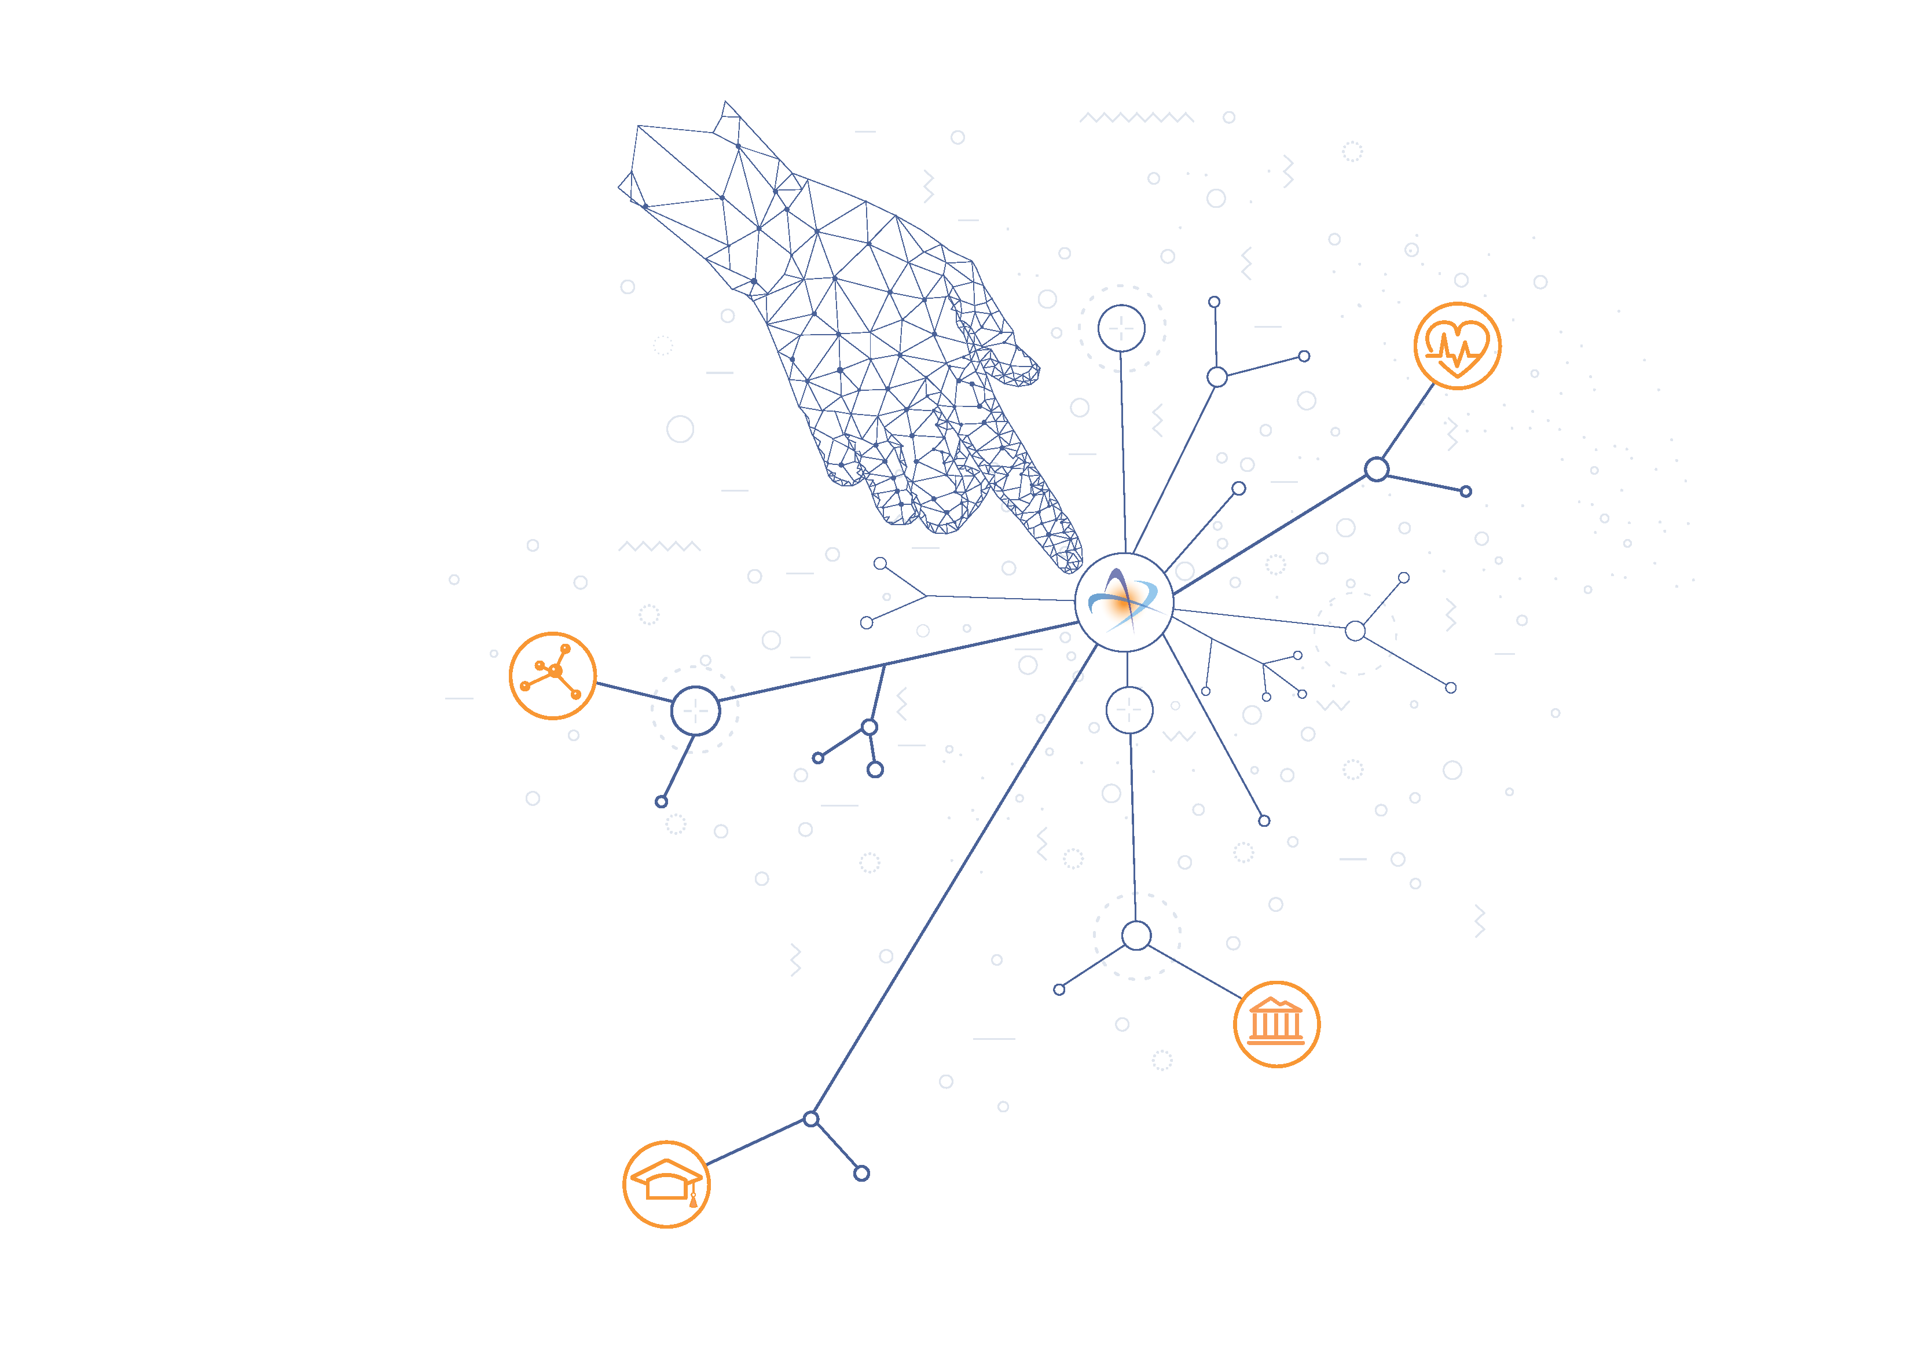
Advanced eInfrastructures & Services

Slide 6

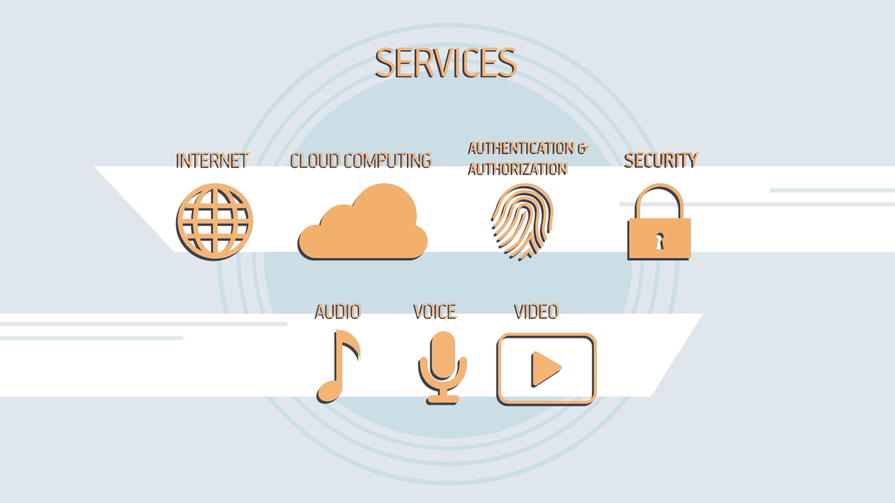
Highlights: eInfrastructures & Services
Nationwide Optical Network Ultra High Speed
Data Centers
Computational and Storage infrastructure
High Performance Computing (HPC) infrastructures
Interconnection Provider GR-IX
Interface with international Internet / GÉANT
Backbone network for the School Network
Fiber optic connections to 31 hospitals, wifi access
Cloud Computing (Okeanos)
High Performance Computing
PITHOS (Storage Service)
University Books (EUDOXUS)
Academic Identity Card
Faculty eVoting
ePresence / Teleconference
Web Casting - Live streaming scientific & cultural events
Hospital Services – imaging backup service, eduroam/edugain access to publications
Infrastructure
Services

Slide 7
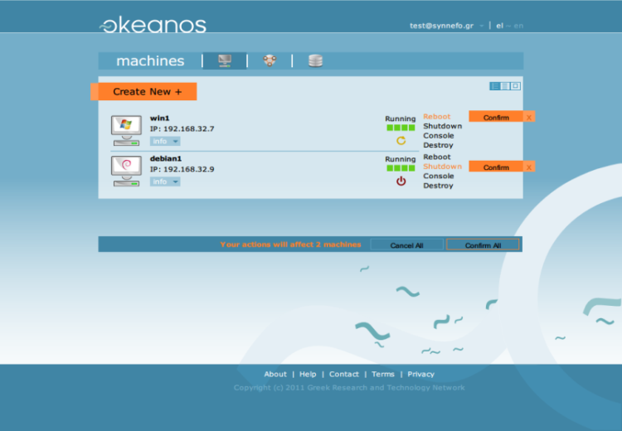
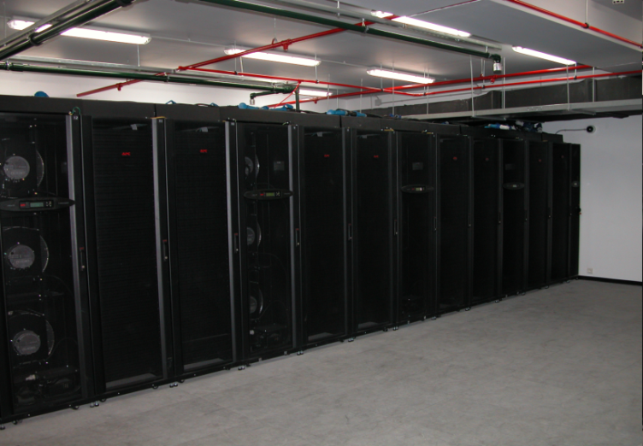
GRNET: Advanced computational and storage services for the research and higher education community
Computers, Networks and Storage for all:
Universities, Research Centers, Institutes, Laboratories, Classes, Students, Researchers
Ability to have a full computer operating system and network in seconds
Development of Information Systems at minimum time, dynamic allocation in real time
Distribution through the Internet (Amazon style-IaaS)
Online file storage and syncing (Pithos+ Service)

Slide 8
Highlights: eInfrastructures and International collaborations
GRNET facilitates the evolution and proliferation of research and technology, by offering opportunities to all its users to develop their academic and scientific activities. Our teams of professionals collaborate with key partners, through national, European and international partnerships, adopt and advance state-of-the-art digital technologies, with the aim to support continuous growth and excellence for the benefit of the Greek society.
Indicative key eInfrastructures and international collaborations GRNET is actively part of:
GÉANT: European collaboration on e-infrastructures and services for Research and Education
PRACE: Partnership for Advanced Computing in Europe
ARIADNE Foundation: Integrating existing archeological data infrastructure across Europe to explore research methodologies
COPERNICUS Data Hubs: Collects, stores and provides access to data from the Sentinel satellites of the Copernicus Earth Observation program
EGI.eu: Federated e-Infrastructure set up for the provision of advanced computing services for Research and Innovation
EUDAT CDI: Collaborative Data Infrastructure
ETP4HPC: European Technology Platform for High Performance Computing
EPIC: European Persistent Identifiers Service
EURO-IX: The European Internet Exchange Association for strengthen and improve the Internet Exchange Point (IXP) community

Slide 9
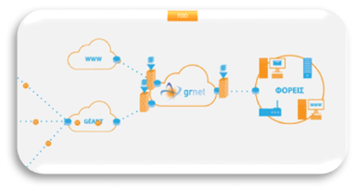
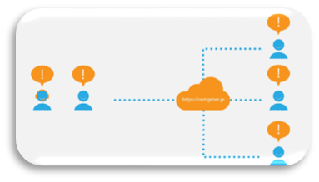


eInfrastructures & Services
Security Services
Firewall on Demand (FoD)
The service enables users to mitigate active attacks aimed at their network equipment
Computer Emergency Response Team (CERT)
GRNET provides incident response and security services, process, correlate and notify end users
DELOS – ΑΑΙ
GRNET “Delos” Authentication and Authorization Infrastructure enables cross-institutional services by providing federated authentication and authorization among participating organizations.
Digital Certificates
Extra security and authentication of people, sites and data transfers

Slide 10
GRNET Handle service

Slide 11
GRNET Handle
Started to experiment with Handle / Pid Service in 2013
Become a full member of the EPIC/PID Consortium in 27-05-2014
GRNET Handle service is a service dedicated to provide, resolve and mint persistent identifiers (PID). ol.
The API supports the following functions
GET for getting the data of a selected PID
POST for creating a new PID with automatic generation of suffix name.
PUT for creating/updating a new PID with manual generation of suffix name
DELETE for deleting a selected PID
PID EPIC is totally (100%) compatible with the DOI and a PID (including the prefix) can also be interpreted from any server DOI.

Slide 12
Current Status
Handle.net software, v.9 Updates done through REST API on primary server
Two servers, hdl.grnet.gr (primary) and hdl2.grnet.gr (mirror).
Replication between primary and mirror performed automatically by the handle.net software
Primary server hosts 10 prefixes, with approx. 9M handles. 20M resolutions/15M updates in 2019.
Mirror hosts the mirror instances of those 10 prefixes, plus mirrors for 2 prefixes of other institutions, plus the EUDAT Central Catalog, which combines the databases of about 14 prefixes.

Slide 13
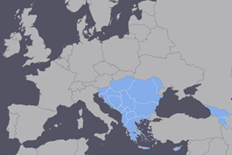
Regions Served by GRNET Handle Service
Europe via EUDAT CDI/EOSC-HUB
Balkan Region vi NI4OS project
GREECE
CLARIN-EL
NOA
Others.

Slide 14
If You built it they will come (#not)
We’ve been advertising the service nationally but uptake is slow
Need clear political mandate / policies
Work in Progress …
GRNET currently participates in the preparation of our National OpenScience/FAIR Strategy (bottom – up Approach)
We recently got the official Mandate to be the Infrastructure Provider for research and education in Greece.
GRNET got also the role/mandate to be technical advisor/cosultant to the Greek Govermenet

Slide 15
National Infrastructures for Research and Technology
edyte

Slide 16
Advanced eInfrastructures & Services
for Health

Slide 17
HPC-ARIS: hpc.grnet.gr
~okeanos: okeanos.grnet.gr
ViMa: vima.grnet.gr
GR-IX: gr-ix.gr
eduroam: eduroam.gr
DIADOSIS: diadosis.grnet.gr
Harmoni: harmoni.grnet.gr
Blood Donor Registry: www.bdr.gr
e:Presence: epresence.grnet.gr
DIAVLOS: diavlos.grnet.gr
Academic IDs: academicid.minedu.gov.gr
FoD: fod.grnet.gr
Security CERT: cert.grnet.gr
Eudoxus: eudoxus.gr
APELLA: apella.minedu.gov.gr
ATLAS: atlas.grnet.gr
PYXIDA: pyxida.grnet.gr

Slide 18
eInfrastructures and International collaborations

Slide 19
National, EU, International Projects

Slide 20
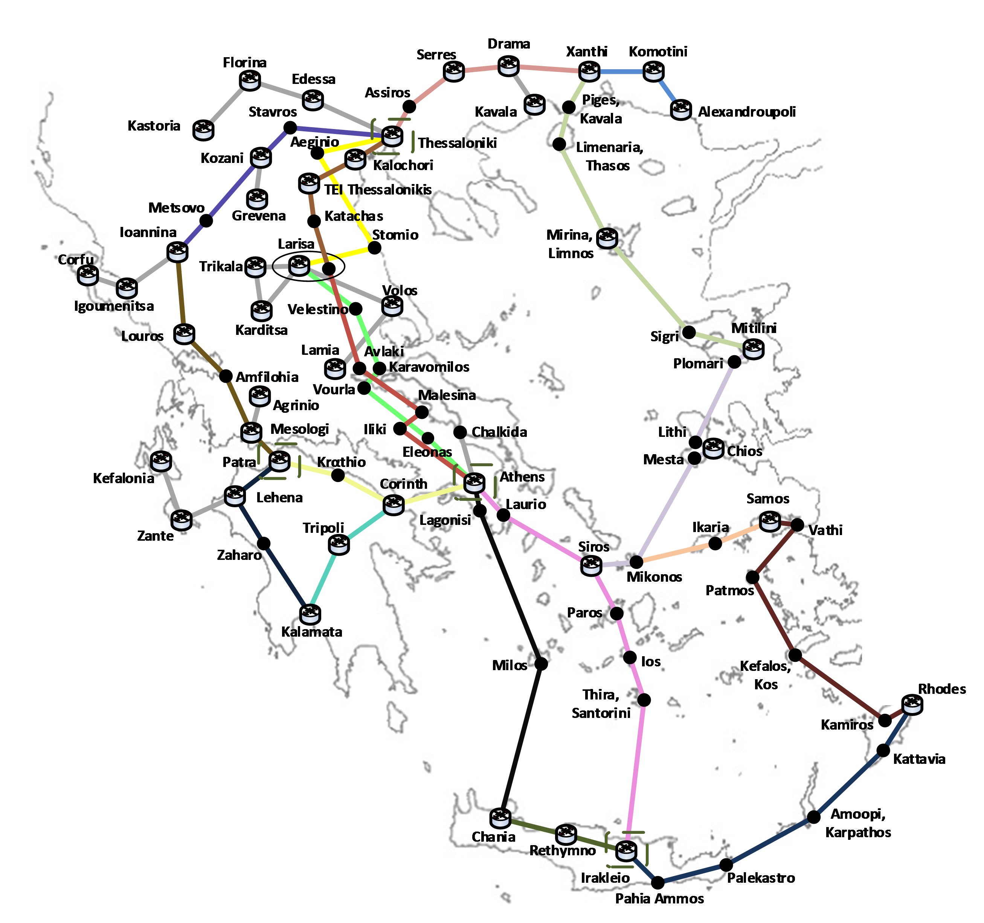

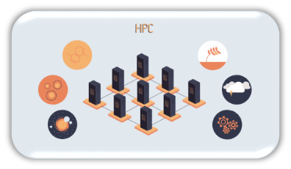
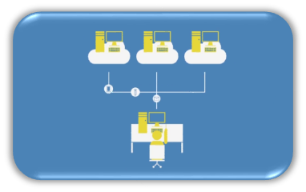
eInfrastructures & Services
GRNET backbone infrastructure
~okeanos is our IaaS Service. “IaaS” stands for “Infrastracture as a Service”. Build your own computer, own virtual machines and virtual networks, always connected to the Internet.
GRNET cloud services - ~okeanos, GREEN DC
~okeanos is our IaaS Service. “IaaS” stands for “Infrastracture as a Service”. Build your own computer, own virtual machines and virtual networks, always connected to the Internet.
National Supercomputer Infrastructure
HPC (High-Performance Computing Services) ΑRIS
HPC services to the Greek R&E community
ViMa Virtual Machines
GRNET ViMa service aims to provide to the Greek educational and academic community access to shared computing and network resources that can be used for production purposes.

Slide 21
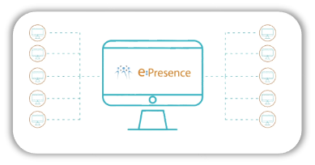
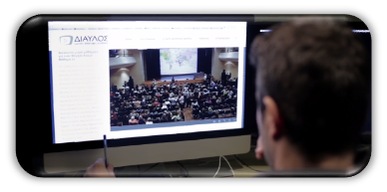
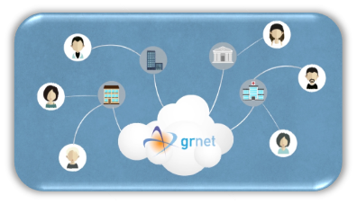


eInfrastructures & Services
e:Presence
Secure, and Greek law compliant videoconference service
For the official meetings of the Greek R&E community
DIAVLOS
“Diavlos” is GRNET’s live streaming service
Lectures, seminars, cultural and other events, which are hosted by major cultural institutions are broadcasted through the GRNET state of the art e-Infrastructure.
eduroam
eduroam (education roaming) is the secure, world-wide roaming access service developed for the international research and education community. It allows students, researchers and staff from participating institutions to obtain Internet connectivity across campus and when visiting other participating institutions by simply opening their laptop.
Pyxida
GRNET’s portal containing educational /training materials for the Services it offers

Slide 22
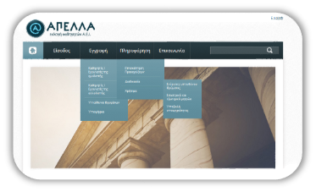




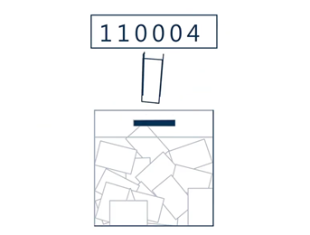
eInfrastructures & Services
APELLA
GRNET “Apella” is an internet service that facilitates the election and promotion of the faculty members of the Greek Academic Institutions
ATLAS
“Atlas” is a centralized online service which interconnects companies that provide internship positions with all academic institutions in Greece by creating a unique internship positions database.
Eudoxus
Electronic book distribution service to students
National Academic ID
The national academic ID service based on DELOS
ZEUS eVoting GRNET “Zeus” is a computing system that ensures the fair conduct of digital private polls carried out remotely with the use of cryptography to ensure validity of results without any breach of secrecy.

Slide 23



Current: National, EU, International Projects
ESA: https://sentinel.esa.int
Funding: «Sentinels Rolling Archive Products User Access, Operations, Maintenance and Evolutions (2015-2020) – European Space Agency (ESA)
Duration: 03/02/2017 - 03/02/2020
SEADATACLOUD: https://www.seadatanet.org/About-us/SeaDataCloud
SeaDataCloud - Further developing the pan-European infrastructure for marine and ocean data management
Funding: European Commission, Horizon 2020
Duration: 01/01/2017 - 31/12/2020
GN4-3 & GN4-3N: https://www.geant.org/Projects/GEANT_Project_GN4-3/
«Research and Education Networking - GÉANT»
Funding: Horizon 2020 - Duration: 01/01/2019 – 31/12/2022
GN4-3N’s mission is to deliver unconstrained access at higher minimum capacity thresholds, highest levels of security across the
network, and equal access to clouds and other services in the European research area and beyond. It will also increase network footprint, future proof connection speeds and stimulate the market in cross-border communications infrastructure while decreasing the digital divide.

Slide 24



Current: National, EU, International Projects
CERTCOOP: https://www.certcoop.eu
Funding: European Commission - Duration: 01/01/2017 - 31/12/2019
The Action will increase the preparedness of the Greek CERTs, by maintaining and expanding existing cybersecurity services and implementing new ones for more efficient cybersecurity information management and incident handling.
AENEAS: https://www.aeneas2020.eu
Advanced European Network of E-infrastructures for Astronomy with the SKA
Funding: European Commission, Horizon 2020 - Duration: 01/01/2017 - 31/12/2019
The objective of the AENEAS project is to develop a concept and design for a distributed, federated European Science Data Centre (ESDC) to support the astronomical community in achieving the scientific goals of the Square Kilometre Array (SKA)
UP2U: https://up2university.eu/up2universe/
Bridging the gap between schools and universities through informal education
Funding: European Commission, Horizon 2020 - Duration: 01/01/2017 - 31/12/2019
The key objective of Up2U project is to bridge the gap between secondary schools and higher education and research by better integrating formal and informal learning scenarios and adapting both the technology and the methodology that students will most likely be facing in universities.

Slide 25



Current: National, EU, International Projects
HEPHAESTUS: https://grnet.gr/grnet_projects/hephaestus/
Funding: NSRF (PA) 2014-2020, Operational Program - Competitiveness, Entrepreneurship and Innovation (EPAnEK) - Duration: 01/10/2017 – 30/09/2021
The Hephaestus project provides all Greek academic and research institutions with advanced network eInfrastructures & Services
HELIX: https://grnet.gr/grnet_projects/helix/
National e-Infrastructures for Research
Funding: EPAnEK / NSRF (PA) 2014-2020 - Duration: 01/01/2017 - 31/12/2021
The project aims at expanding / upgrading and making available for use by the national research infrastructures the NNCRI (National Network and Computational Research Infrastructure), OpenAIRE-D and HELNET, as listed under the consolidated title National Digital Infrastructures for Research (HELIX) in the National Roadmap for Research Infrastructures
ELIXIR-GR: https://www.elixir-europe.org/about-us/who-we-are/nodes/greece
The Greek research infrastructure for data management & analysis in the Bioscience
Funding: EPAnEK / NSRF (PA) 2014-2020 - Duration: 01/01/2017 - 31/12/2019
SPRICE
SPRICE
Funding: EPAnEK / NSRF (PA) 2014-2020 - Duration: 02/05/2017 - 30/04/2020
The project aims to implement intelligent and effective mechanisms for deploying virtual machines and containers in a cloud computing environment.

Slide 26




Current: National, EU, International Projects
APOLLONIS: https://apollonis-infrastructure.gr
National Infrastructure for Digital Humanities and Sciences and for linguistic Research and Innovation
Funding: EPAnEK / NSRF (PA) 2014-2020 - Duration: 02/05/2017 - 30/04/2020
ENEDI: https://enedi.eu
Energy saving management systems for Data Centers in public Academic buildings
Funding: European Commission, Cooperation Programme INTERREG V-A “Greece – Cyprus 2014-2020”- Duration: 01/11/2017 - 31/10/2019
EOSC HUB: https://www.eosc-hub.eu/
Integrating and managing services for the European Open Science Cloud
Funding: HORIZON 2020 - Duration: 01/01/2018 - 31/12/2020
EOSC-hub brings together multiple service providers to create a single contact point for European researchers and innovators to discover, access, use and reuse a broad spectrum of resources for advanced data-driven research.
Synthesis+: http://www.synthesys.info/
Synthesis of systematic resources
Funding: HORIZON 2020 - Duration: 01/02/2019 - 31/01/2023
SYNTHESYS aims to produce an accessible, shared, high quality approach to the management, preservation and access integrated European resource to leading European natural history collections for research users in the natural sciences.

Slide 27



Current: National, EU, International Projects
HPC-EUROPA3: http://www.hpc-europa.eu/
Transnational Access Programme Pan-European Research Infrastructure on High Performance Computing
Funding: HORIZON 2020 / European Commission - Duration: 01/05/2017 - 30/04/2021
The main objective of the HPC-Europa3 project is to maintain the high quality of transnational access services to some of Europe's most advanced supercomputing infrastructures in the European community of computer science researchers.
PRACΕ-6IP: http://www.prace-ri.eu/
Partnership for Advanced Computing in Europe
Funding: H2020-EINFRA-2016-2017 e-Ιnfrastructures, Work Programme 2018-2020
Duration: 01/05/2019-31/12/2021
The mission of PRACE is to enable high-impact scientific discovery and engineering research and development across all disciplines to enhance European competitiveness for the benefit of society.
DIVA: https://www.projectdiva.eu
Boosting innovative Digitech Value chains for Agrofood, forestry and environment
Funding: Horizon 2020- Duration: 01/04/2018-31/03/2021
The project focuses on promoting innovation in the agro-food, forestry and environment sectors. DIVA aims in achieving widespread use of digital technologies by focusing on digital markets, big data and cloud computing, robotics and artificial intelligence, IoT as well as electronics and photonics.

Slide 28


Current: National, EU, International Projects
DARE: http://project-dare.eu/
Delivering Agile Research Excellence
Funding: Horizon 2020- Duration: 01/01/2018 - 31/12/2020
DARE focuses on big-data analysis research activity. The project objective is to develop and implement a technology platform that combines data, analytical methods and infrastructures.
CEF EID: https://grnet.gr/grnet_projects/cef-eid/
e-Signature and Erasmus Student eCard in Greece
Funding: European Commission - Duration: 01/09/2018 - 01/03/2020
GRNET’s purpose by participating in the CEF EID project is to interface the Electronic Academic Identification Service under the section «eIDAS enabled Erasmus Student. eCard» and support/ensure the prompt provision of academic identity card for Erasmus students from a central point by using eID
CEF EID
eury-where: https://www.eury-where.gr/
Funded broadband digital services to eligible undergraduate freshmen of all national universities, TEIs and AEAs
Funding: ΕΕΤΤ - Duration: 01/01/2017 - 31/12/2020
The action is about providing digital services to eligible undergraduate freshmen at the all national universities, TEIs and AEAs, who are enrolling for the first time in a Higher Education Institution in the academic year 2018 - 2019

Slide 29


Current: National, EU, International Projects
PRiVILEDGE: https://priviledge-project.eu/
Privacy-Enhancing Cryptography in Distributed Ledgers
Funding: Horizon 2020- Duration:01/01/2018 - 31/12/2020
The aim of the project PRIViLEDGE is to develop and advance techniques that enhance privacy, anonymity and efficient decentralized consensus for distributed ledgers technologies (DLT).V
OpenAIRE-Advance: https://www.openaire.eu/advance/
Funding: Horizon 2020- Duration:01/01/2018 - 31/12/2020
H2020 project consolidating and operating OpenAIRE services, making them EOSC compatible.
NI4OS-Europe: https://www.ni4os.eu/
National Initiatives for Open Science in Europe
Funding: Horizon 2020- Duration:01/09/2019 - 31/08/2022
Digital Services for the National Blood Donation System
Digital Services for the National Blood Donation System
Funding: «REFORMATION of PUBLIC SECTOR» 2014-2020
Duration:26/04/2016 - 30/06/2023

